Slide 1
Cosmo-Truckers

Slide 2

Agenda
Engineering
Design
Music Production
Interconnectivity

Slide 3
Engineering
Chance, Mike, and Cole

Slide 4
Engineering Work
Tasks
Connections
Combat base system
Combat UI
Attacking
Defending
Buffs
Debuffs
Tile based movement for HUB
Saving / loading data
Crafting system
Enemy AI
Player Input
Dungeon Generation
Map Navigation
Networking (up to four players local hosting)
Chance and I will be the main developers on the project and will likely be communicating most of our work between each other in terms of back-end development
When we begin to move onto more front-end features, Cole will be more closely tied into our decision-making process

Slide 5
Design
Cole, Mike, and Chance

Slide 6
Design Work
Tasks
Connections
Each dimension will require lore, character designs, enemy designs, and storylines. For the prototype there will be only one dimension to focus on
Overarching story design
Player character specifications, backgrounds, and combat specifics
Combat mini-game designs
Combat buff / debuff designs
In this role, you are likely going to span across everyone’s role on the team. It is up to you to make sure that I am meeting your visions in the art department, Chance is meeting your visions in the engineering department, and Dillan is meeting your visions in the sound department. We may have suggestions to you for our work, but ultimately if you are confident in a design choice, we need to work together to achieve that vision

Slide 7
Music Production
Dillan

Slide 8
Music Production Work
Tasks
Connections
Each week, you will continue to work on any tracks that are necessary for the current content being produced by the rest of the team
In terms of the pre-production stage, this will include main menu music, HUB music, prototype dimension BG music, one combat track, and one boss combat track
As far as inspiration goes, Cole may be of the best assistance when helping you to envision what a certain area may sound like
Being the art person (at least for the prototype), you can also reach out to me regarding any art assets we may have for a zone that can also assist in the artistic process of music production

Slide 9
Interconnectivity
Mike, Chance, Cole, and Dillan

Slide 10
Interconnectivity Work
Tasks
Trello
We will all each have our own tasks and goals going forward, but keeping open lines of communication as well as updated Trello cards will help team members with overlap better understand where tasks are at
This will also reduce the number of conflicts that occur in the repository
Whenever you complete a task and push changes, update the respective Trello card and make a post in #Todays-Work. As the team works on more narrow concepts, it will be important that other members know when they will have access to a specific portion of the code base.

Slide 11
Team
Mike Sroka
Business Operations, Engineering, Art, and Design
Aaron “Chance” King
Smart Engineer, and Design
Cole Miller
World Building, Character Design, Combat Design, and Combat Engineering
Dillan Briggs
Music Producer

Slide 12
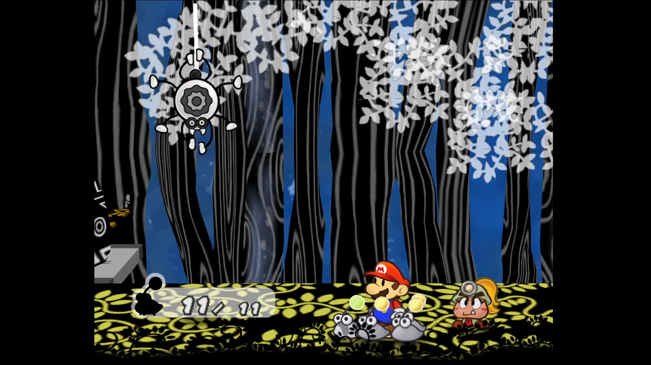

Slide 13
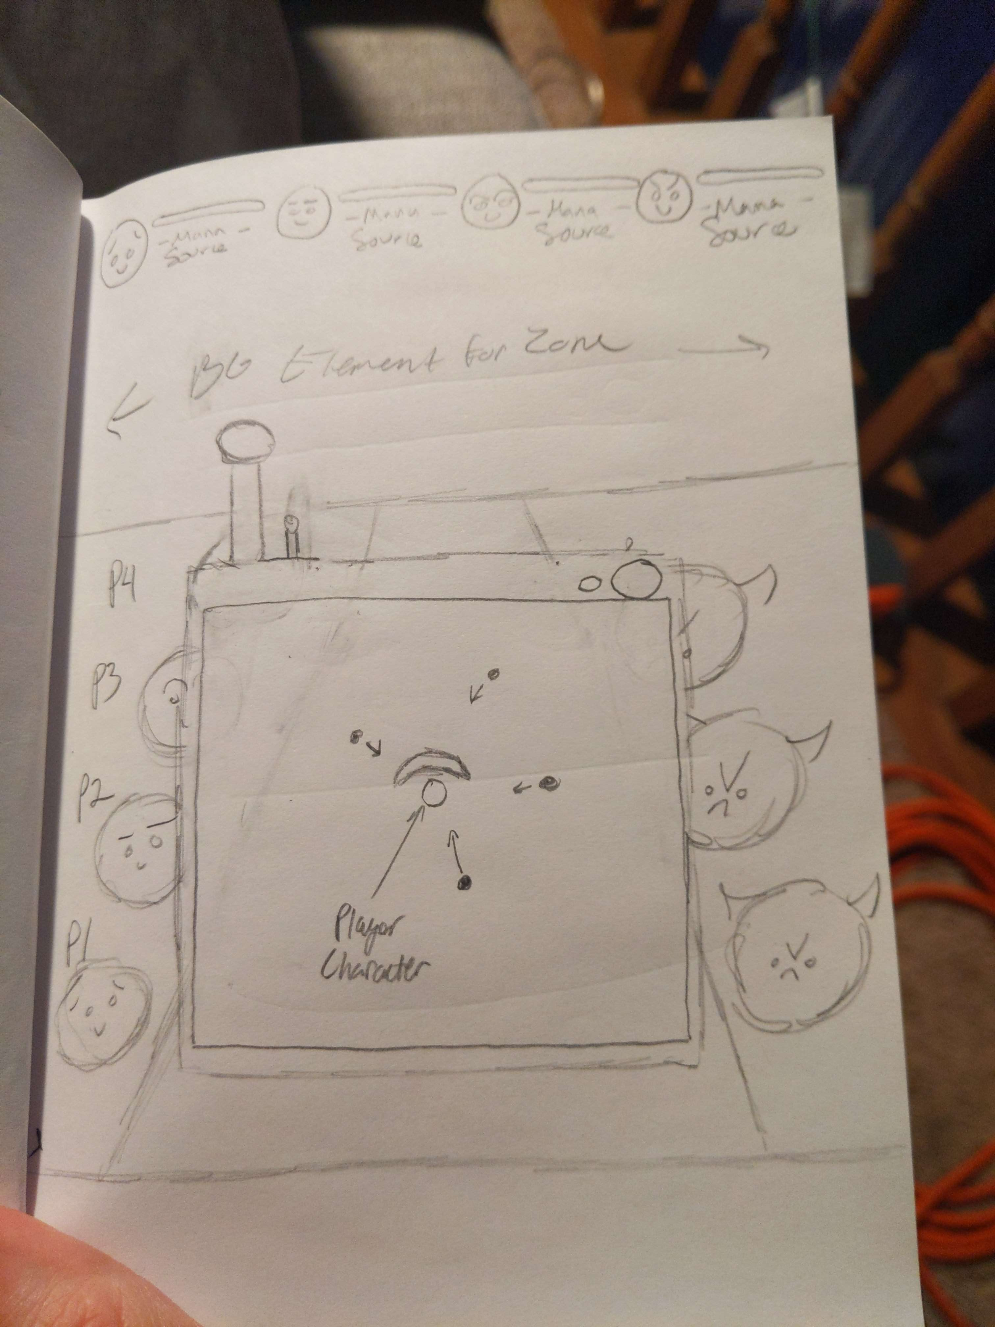
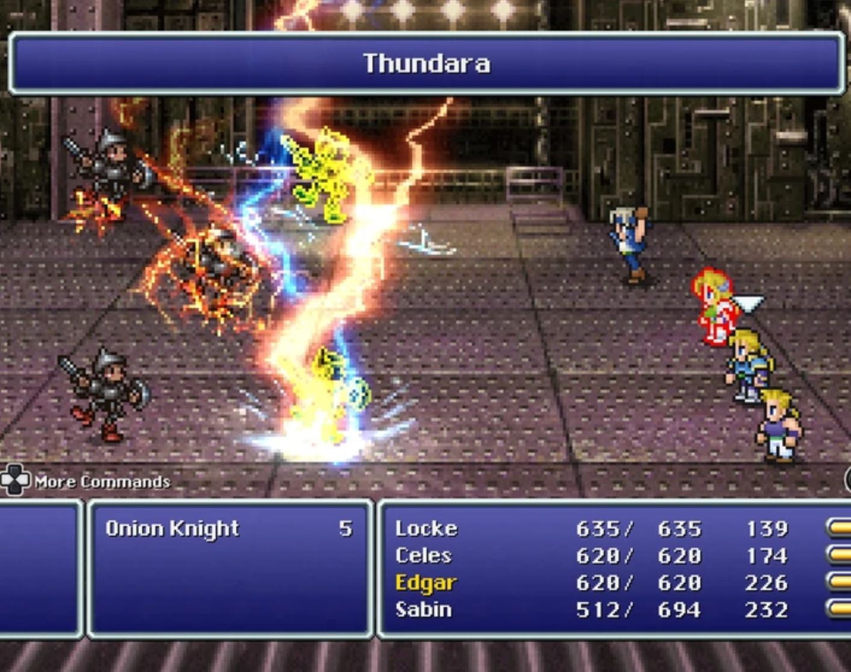
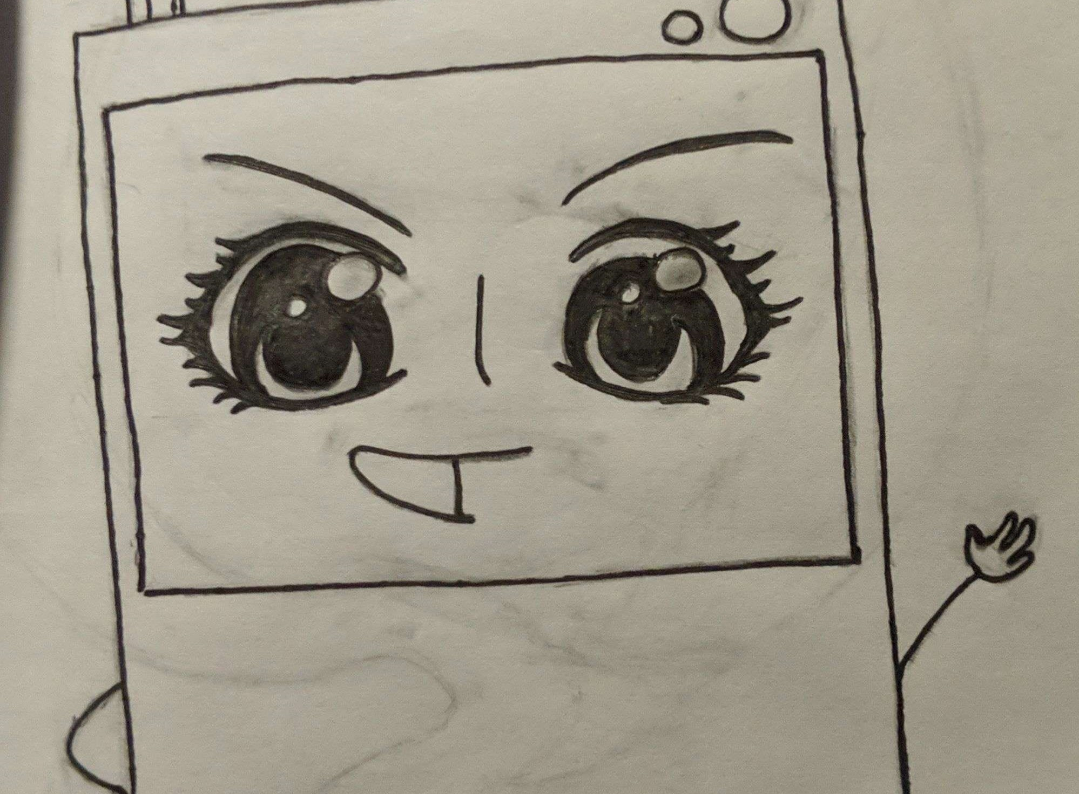
Combat Layout

Slide 14
Timeline
Pre-production
During this 3-6 month period, we will work on completing a prototype polished enough for the team to present to potential publishers, crowd funding, etc.
Alpha Milestone
In another 6-9 months, we should have the bare minimum of each idea implemented into the game. There is a beginning and end to the project at this point.
Beta Milestone
This will likely be the bulk of the work and is estimated to take somewhere between 6-12 months to add robustness to the game.
Gold Milestone
During production of our gold version, any Kickstarter goals will be implemented, bugs will be fixed, and playtesting will ensue taking 4-6 months.
Post-production
Should the project exceed monetary expectations and the team wants to continue work, DLC and further content can be added to the project as the team sees fit

